Slide 1
Unit – 2
Process Management

Slide 2
Process Overview
Process is a program in execution.
By switching the CPU between processes, the OS can make the computer more productive.
CPU activities can be called by many names. A batch system executes Jobs, whereas a time shared system has user programs, or tasks.
In many respects, all these activities are similar, so we call all of them processes.

Slide 3
The Process
A process is more than the program code, which is sometimes known as the text section.
It also includes the current activity, as represented by the value of the program counter and the contents of the processor’s registers.
A process generally also includes the process stack, which contains temporary data such as function parameters, return addresses and local variables.

Slide 4
The Process
A data section contains global variables.
A process may also include a heap, which is memory that is dynamically allocated during process run time.
Program is a passive entity, such as a file containing a list of instructions stored on disk.
A process is an active entity, with a program counter specifying the next instruction to execute and a set of associated resources.

Slide 5
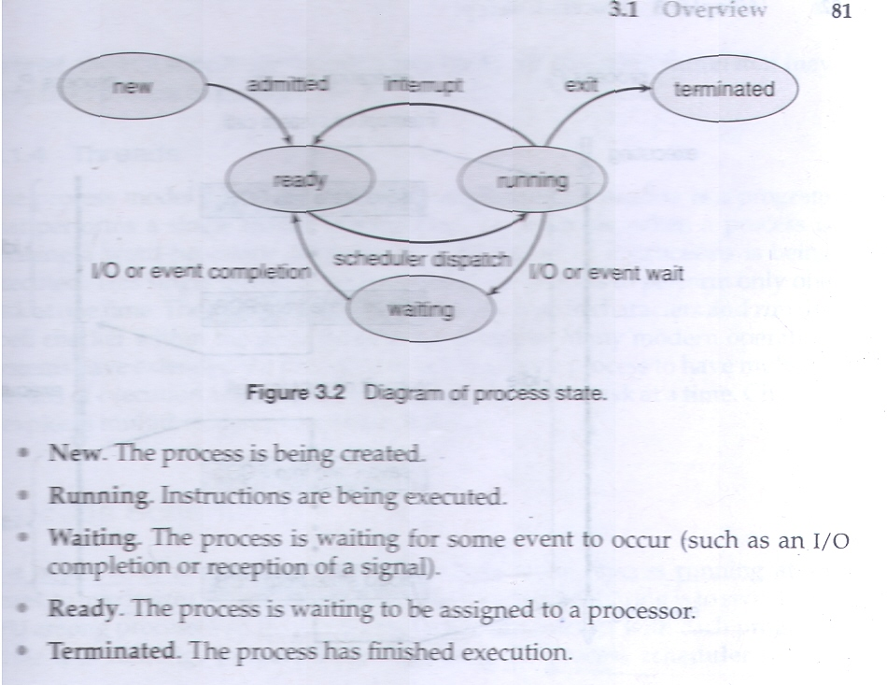
Process State

Slide 6
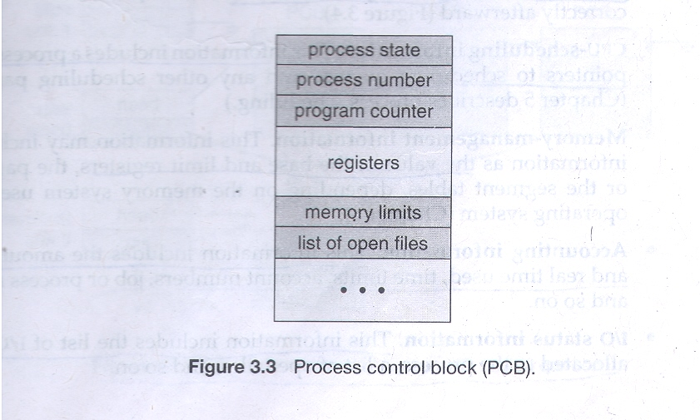
Process Control Block

Slide 7
Process Control Block
Each process is represented in the operating system by a process control block (PCB) – also called task control block.
Process state: (Any on of the states)
Program counter: the counter indicates the address of the next instruction to be executed for this process.
CPU registers: along with the program counter, this state information must be saved when an interrupt occurs, to allow the process to be continued correctly afterward.
CPU scheduling information: this information includes a process priority, pointer to scheduling queues, and any other scheduling parameters.

Slide 8
Process Control Block
Memory Management Information: this information may include such information as the value of the base and limit registers, the page tables, etc.
Accounting information: this information includes the amount of CPU and real time used, time limits, account numbers, job or process numbers and so on.
I/O status information: this information includes the list of I/O devices allocated to the process, a list of open files and so on.
In brief, the PCB simply serves as the repository for any information that may vary from process to process.

Slide 9
Process Scheduling
The objective of multiprogramming is to have some process running at all times, to maximize CPU utilization.
The objective of time sharing is to switch the CPU among processes so frequently that users can interact with each program while it is running.
To meet these objectives, the process scheduler selects an available process for program execution on the CPU.

Slide 10
Scheduling Queues
As processes enter the system, they are put into a job queue, which consists of all processes in the system.
The processes that are residing in main memory and are ready and waiting to execute are kept on a list called ready queue. This queue is generally stored as a linked list.
A ready queue header contains pointers to the first and final PCBs in the list. Each PCB includes a pointer field that points to the next PCB in the ready queue.
The list of processes waiting for a particular I/O device is called a device queue. Each device has its own device queue.

Slide 11
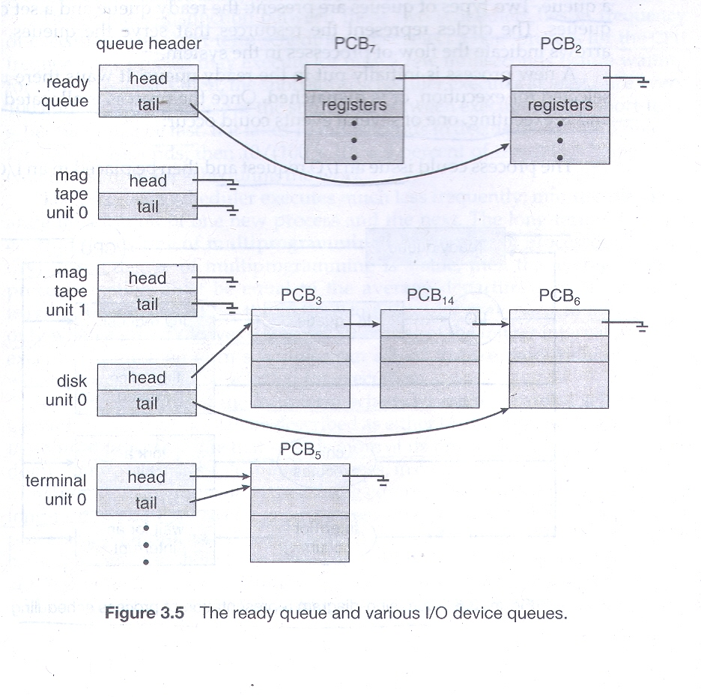
Scheduling Queues

Slide 12
Queuing Diagram
A common representation for a discussion of process scheduling is queuing diagram.
Each rectangular box represents a queue.
Two types of queues are present: the ready queue and a set of device queues.
The circles represent the resources that serve the queues, and the arrows indicate the flow of processes in the system.

Slide 13
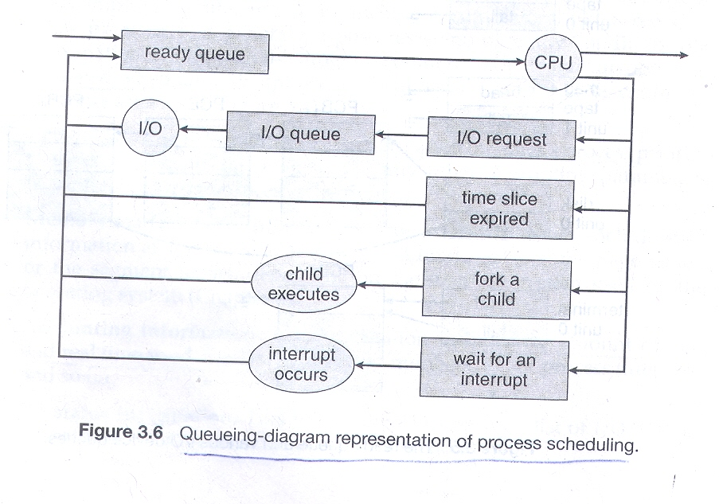
Queuing Diagram

Slide 14
Queuing Diagram
A new process is initially put in the ready queue. It waits there until it is selected for execution, or is dispatched.
Once the process is allocated the CPU and is executing, one of the several events could occur:
The process could issue an I/O request and then be placed in an I/O queue.
The process could create a new sub process and wait for the sub process’ termination.
The process could be removed forcibly from the CPU, as a result of an interrupt, and be put back in the ready queue.

Slide 15
Schedulers
The operating system must select processes from various queues in some fashion.
The selection process is carried out by the appropriate scheduler.
In batch system, more processes are submitted than can be executed immediately.
These processes are kept on disk, where they are kept for later execution.
The long-term scheduler or job scheduler, selects processes from this pool and loads them into memory for execution.

Slide 16
Schedulers
The CPU scheduler or short-term scheduler selects from among processes that are ready to execute and allocates the CPU to one of them.
The primary difference between these two schedulers lies in frequency of execution.
The long term scheduler controls the degree of multiprogramming i.e. the number of processes in memory.
The long term scheduler may need to be invoked when process leaves the system.

Slide 17
Schedulers
A long term scheduler has to make correct selection between I/O bound processes and CPU bound processes. It should select good process mix of I/O bound and CPU bound processes.
If all processes are I/O bound, the ready queue will almost always be empty, and the short term scheduler will have little to do.
If all processes are CPU bound, the I/O waiting queue will almost always be empty, devices will go unused, and again the system will be unbalanced.
On some systems, long term scheduler may be absent or minimal.
For example, in UNIX and windows systems often have no long-term scheduler but simply put every new process in memory for the short term scheduler.

Slide 18
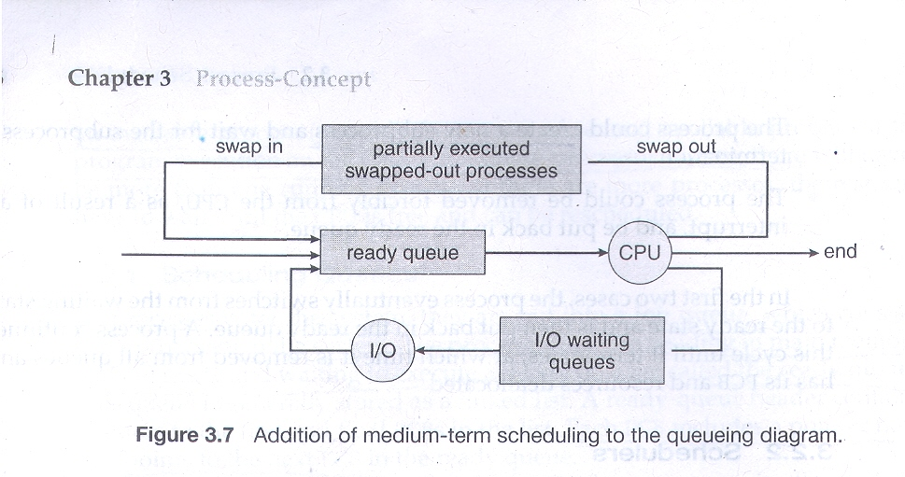
Medium term scheduler

Slide 19
Medium term scheduler
The key idea behind the medium term scheduler is that sometimes it can be advantageous to remove processes from memory and thus reduce the degree of multiprogramming.
Later, the process can be reintroduced into memory, and its execution can be continued where it left off ( Swapping ).
Swapping is done by the medium term scheduler.

Slide 20
Context Switch
When an interrupt occurs, the system needs to save the current context of the process currently running on the CPU so that it can restore that context when its processing is done, essentially suspending the process and then resuming it.
The context is represented in the PCB of the process; it includes the value of the CPU registers, the process state etc.
Switching the CPU to another process requires performing a state save of the current process and a state restore of a different process. This task is known as a context switch.
When a context switch occurs, the kernel saves the context of the old process in its PCB and loads the saved context of the new process scheduled to run.
Context switch time is pure overhead. Its speed varies from machine to machine.

Slide 21
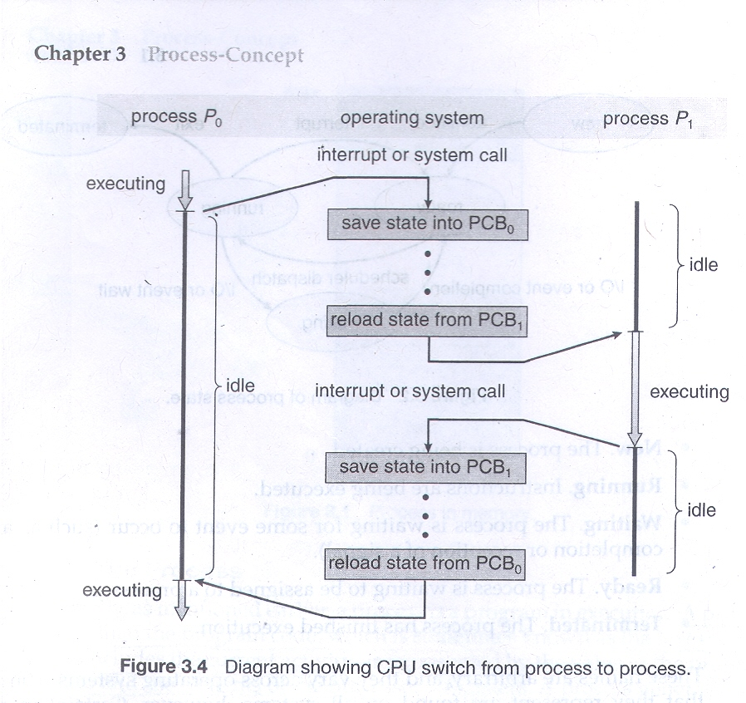
Context Switch

Slide 22
Inter Process Communication
A process is independent if it cannot affect or be affected by the other processes executing in the system.
Any process that does not share data with any other process is independent.
A process is cooperating if it can affect or be affected by the other processes executing in the system.
There are several reasons for providing an environment that allows process cooperation.

Slide 23
Reasons for Process cooperation
Information sharing: since several users may be interested in the same piece of information, we must provide an environment to allow concurrent access to such information.
Computation speedup: if we want a particular task to run faster, we must break it into subtasks, each of which will be executing in parallel with the others.
Modularity: we may want to divide the system functions into separate processes or threads.
Convenience: even an individual user may work on many tasks at the same time.

Slide 24
Inter Process Communication
Cooperating processes require an inter processes communication (IPC) mechanism that will allow them to exchange data and information.
There are two fundamental methods of inter process communication.
Shared Memory: in this, a region of memory that is shared by cooperating processes is established. Processes can then exchange information by reading and writing data to the shared region.
Message Passing: in this, communication takes place by means of messages exchanged between the cooperating processes.

Slide 25
Inter Process Communication
Both of the models are common in OS, and many systems implement both.
Message passing is useful for exchanging small amount of data.
Message passing is also easier to implement than is shared memory for inter-computer communication.
Shared memory allows maximum speed and convenience of communication, as it can be done at memory speeds when within a computer.

Slide 26
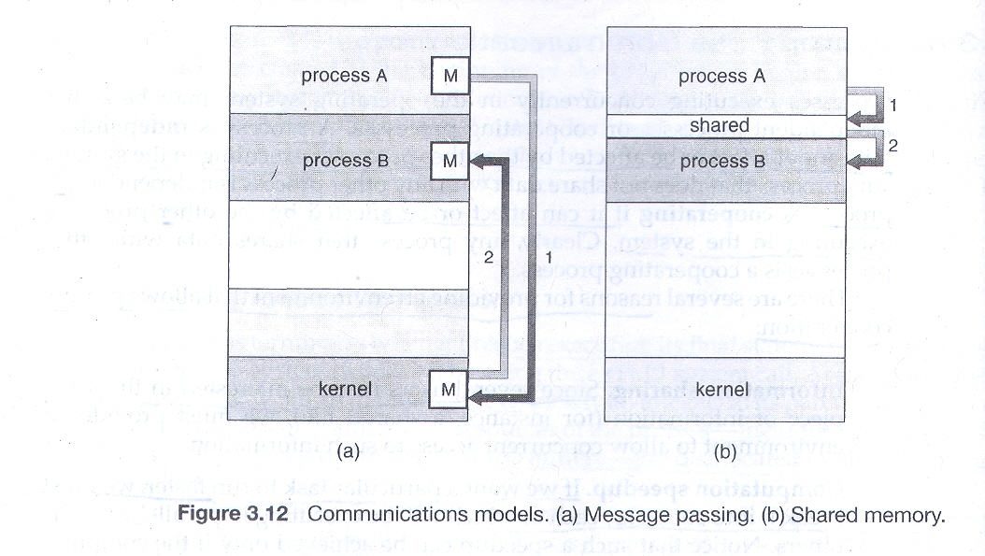
Models of Inter Process Communication

Slide 27
Shared Memory Systems
Inter-process communication using shared memory requires communicating processes to establish a region of shared memory.
Normally, the OS tries to prevent one process from accessing another process’s memory. Shared memory requires that two or more processes agree to remove this restriction.
They can then exchange information by reading and writing data in the shared areas.
The form of data and the location are determined by these processes and are not under the OS’s control.
The processes are also responsible for ensuring that they are not writing to the same location simultaneously.

Slide 28
Message Passing System
Message passing facility provides a mechanism to allow processes to communicate and to synchronize their actions without sharing the same address space.
It is particularly useful in a distributed environment, where the communicating processes may reside on different computers connected by a network.
A message passing facility provides at least two operations: send(message) and receive(message)
Messages sent by a process can be of either fixed or variable size

Slide 29
Message Passing System
If only fixed-sized messages can be sent, the system level implementation is straightforward. This restriction makes the task of programming more difficult.
Conversely, variable-sized messages require a more complex system level implementation, but the programming task becomes simpler.
If processes P and Q want to communicate, they must send messages to and receive messages from each other.

Slide 30
Multithreaded Programming
A thread is a basic unit of CPU utilization. It comprises a thread ID, a program counter, a register set and a stack.
It shares with other threads belonging to the same process its code section, data section, and other operating system resources, such as open files and signals.
A traditional or heavyweight process has a single thread of control.
If a process has multiple threads of control, it can perform more than one task at a time.

Slide 31
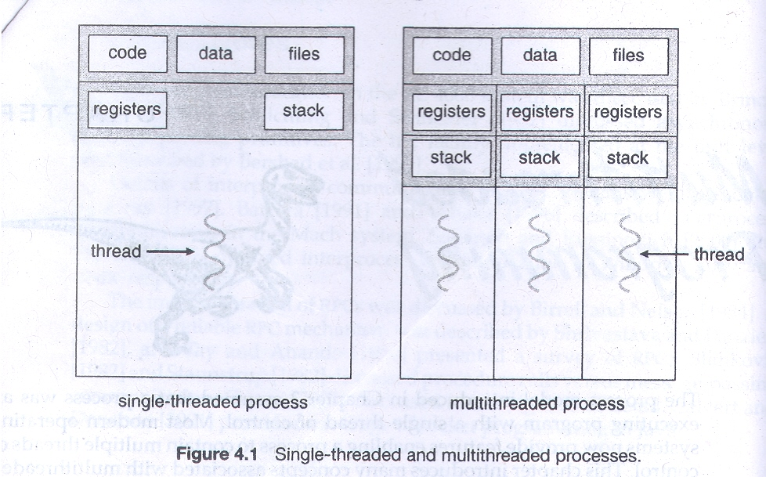
Multithreaded Programming

Slide 32
Reasons for Multithreading
In certain situations, a single application may be required to perform several similar tasks. For example, a web server.
A web server accepts client requests for web pages, images, sound, and so forth.
A busy web server may have several of clients concurrently accessing it. If web server ran as a traditional single-threaded process, it would be able to service only one client at a time.
The amount of time that a client might have to wait for its request to be serviced could be enormous.
One solution is to have the server run as a single process that accepts requests. When the server receives a request, it creates a separate process to service that request.

Slide 33
Reasons for Multithreading
Process creation is time consuming and resource intensive.
It is generally more efficient to use one process that contains multiple threads.
This approach would multithread the web server process.
The server would create a separate thread that would listen for client requests; when a request was made, rather than creating another process, the server would create another thread to service the request.
Many OS kernels are also multithreaded. Each thread performs a specific task.

Slide 34
Benefits of Multithreading
Responsiveness: program can be continued if part of it is blocked or is performing a lengthy operation.
  For example, a multithreaded web browser could still allow user interaction in one thread while an image was being loaded in another thread.
Resource sharing: threads share memory and the resources of the process to which they belong.
  It allows an application to have several different threads of activity within the same address space.

Slide 35
Benefits of Multithreading
Economy: it saves memory and resources for process. It is economical to context-switch threads.
  For example, in Solaris, creating a process is about thirty times slower than is creating a thread, and context switching is about five times slower.
Utilization of multiprocessor architectures: threads may be running in parallel on different processors.
  A single thread process can only run on one CPU, no matter how many are available.

Slide 36
Multithreading Models
Support for threads may be provided either at user level, for user threads or by the kernel, for kernel threads.
User threads are supported above the kernel and are managed without kernel support, whereas kernel threads are supported and managed directly by the OS.
There must exists a relationship between user threads and kernel threads.
Three common ways to establish this relationship are:
Many to One Model
One to One Model
Many to Many Model

Slide 37
Many to One Model
Many to One Model maps many user level threads to one kernel thread.
The management is done by the thread library in user space, so it is efficient; but the entire process will block if a thread makes a blocking system call.
Because only one thread can access the kernel at a time, multiple threads are unable to run in parallel on multiprocessors.

Slide 38
One to One model
This model maps each user thread to kernel thread.
It provides more concurrency than the many to one model by allowing another thread to run when a thread makes a blocking system call;
It also allows multiple threads to run in parallel on multiprocessors.
The only drawback to this model is that creating a user thread requires creating the corresponding kernel thread.
Because the overhead of creating kernel threads can burden the performance of an application, most implementations of this model restrict the number of threads supported by the system
Linux and Windows use this model.

Slide 39
Many to Many Model
The many to many model multiplexes many user level threads to a smaller or equal number of kernel threads.
This model overcomes the short comings or above two models.
The many to one model allows the developer to create as many user threads as he wants, but true concurrency is not gained because the kernel can schedule only one thread at a time.
The one to one model allows for greater concurrency, but the developer has to careful not to create too many threads within an application.
Developers can create as many user threads as necessary, and the kernel threads can run in parallel on a multiprocessor.
Also when a thread performs a blocking system call, the kernel can schedule another thread for execution
One variation on the many to many model still multiplexes many user level threads to a smaller or equal number of kernel threads but also allows a user level thread to be bound to a kernel thread.
This variation is called two level model. It is supported by OS like IRIX, and Tru64 UNIX

Slide 40
Process Scheduling
The objective of multiprogramming to have some process running at al times, to maximize CPU utilization.
Scheduling is a fundamental operating system function.
Almost all computer resources are scheduled before use.
The CPU is one of the primary computer resources. Thus, its scheduling is central to OS design.

Slide 41
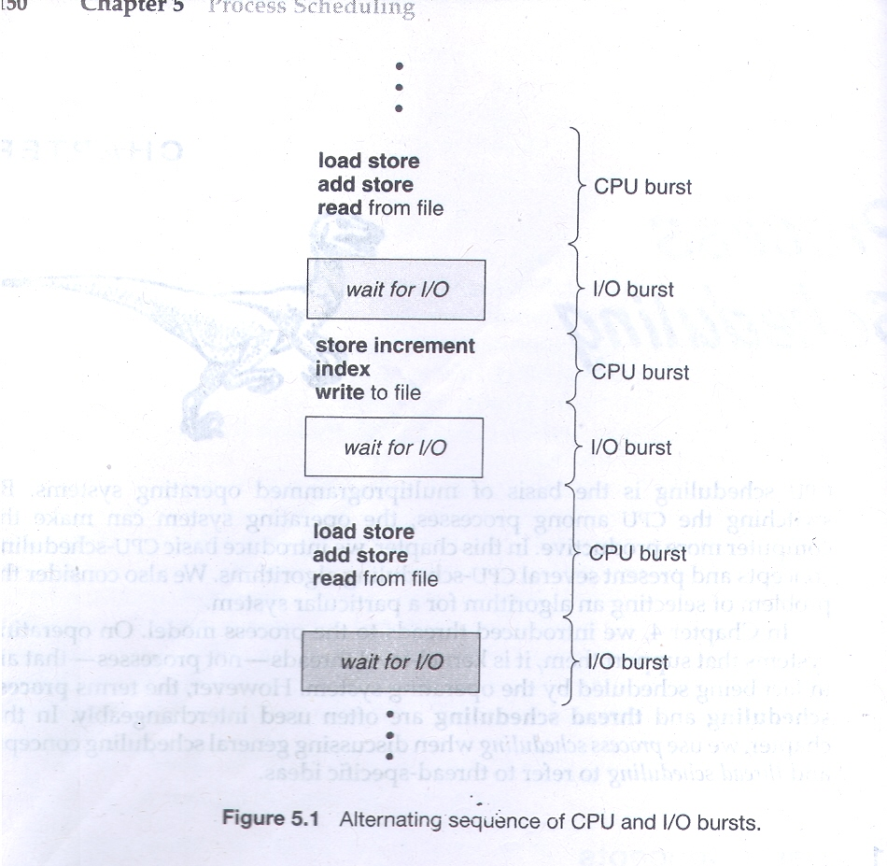
CPU-I/O Burst Cycle

Slide 42
CPU-I/O Burst Cycle
Process execution consists of a cycle of CPU execution and I/O wait.
Process alternates between these two states.
Process execution begins with a CPU burst.
It is followed by an I/O burst, which is followed by another CPU burst and so on.
The final CPU burst ends with a system request to terminate execution.
An I/O bound program typically has many short CPU bursts. A CPU bound program might have a few long CPU bursts.

Slide 43
CPU Scheduler
Whenever the CPU becomes idle, the OS must select one of the processes in the ready queue to be executed.
The selection process is carried out by the short term scheduler or CPU scheduler.
The CPU scheduler selects a process from the processes in memory that are ready to execute and allocates the CPU to that process.
Conceptually, all the processes in the ready queue are lined up waiting for a chance to run on the CPU.
The records in the queue are generally PCB of the process.

Slide 44
Preemptive Scheduling
CPU scheduling decisions may take place under the following four circumstances:
When a process switches from the running state to the waiting state. ( the result of an I/O request or an invocation of wait system call)
When a process switches from the running state to the ready state ( interrupt occurs)
When a process switches from the waiting state to the ready state. (completion of I/O)
When a process terminates.

Slide 45
Preemptive Scheduling
For situations 1 and 4, there is no choice in terms of scheduling. A new process must be selected for execution. There is choice for situations 2 and 3.
When scheduling takes place only under circumstances 1 and 4, we say that the scheduling scheme is nonpreemptive or cooperative; otherwise it is preemptive.
Under nonpreemptive scheduling, once the CPU has been allocated to a process, the process keeps the CPU until it releases the CPU either by terminating or by switching to the waiting state. It is used by Windows 3.x, earlier versions of Mac OS X.
Preemptive scheduling may create complications in access of same data by two or more processes.

Slide 46
Dispatcher
The dispatcher is the module that gives control of the CPU to the process selected by the short-term scheduler.
This function involves : switching context, switching to user mode, jumping the proper location in the user program to restart that program.
The dispatcher should be as fast as possible, since it is invoked during every process switch.
The time it takes for the dispatcher to stop one process and start another running is known as the dispatch latency.

Slide 47
Scheduling Criteria
Following are the criteria to judge which CPU scheduling algorithm is best in particular situation:
CPU utilization: CPU utilization should be maximum.
Throughput: the number of processes that are completed per time unit, is called the throughput.
  For long processes, this rate may be one process per hour; for short once, it may be 10 processes per second.
Turnaround time: it tells how long it takes to execute that process. The interval from the time of submission of a process to the time of completion is the turnaround time.
  It is the sum of the periods spent waiting to get into memory, waiting in the ready queue, executing on the CPU, and doing I/O.

Slide 48
Scheduling Criteria
Waiting time: the CPU scheduling algorithm affects only the amount of time that a process spends waiting in the ready queue.
  Waiting time is the sum of the periods spent waiting in the ready queue.
Response time: response time is the measure of the time from the submission of a request until the first response is produced.
  It is the time it takes to start responding, not the time it takes to output the response.
It is desirable to maximize CPU utilization and throughput and to minimize turnaround time, waiting time and response time.

Slide 49
Scheduling Algorithms
FCFS
Shortest-Job-First Scheduling
Priority Scheduling
Round-Robin Scheduling
(Above Four Algorithms are Explained using Gantt Chart and Calculating Average Waiting Time by giving suitable examples, along with merits and demerits of these algorithms.)

